Slide 1
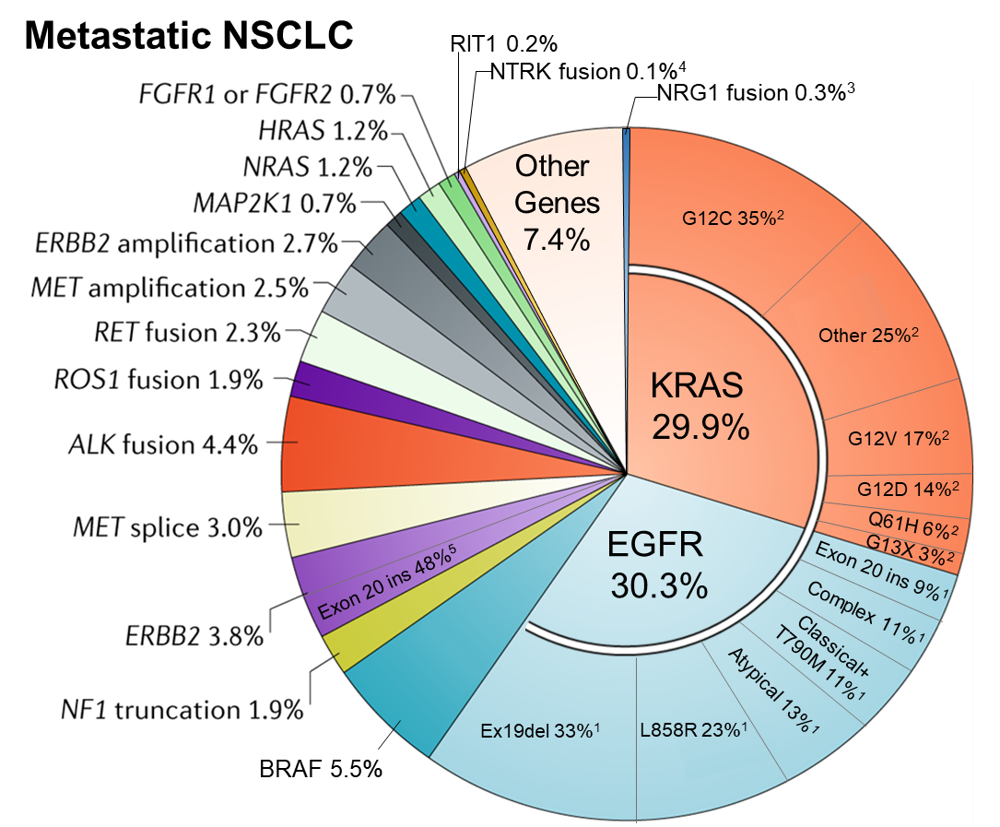

Adapted from Skoulidis and Heymach 2019 Nat Rev Can
¹ Robichaux et al 2020 WCLC
² Mack et al 2020 Cancer
³ Jonna et al 2019 Clin Can Res
⁴ Russo et al 2020 Precis Cancer Med
⁵ Robichaux et al 2019 Cancer Cell

